Slide 1


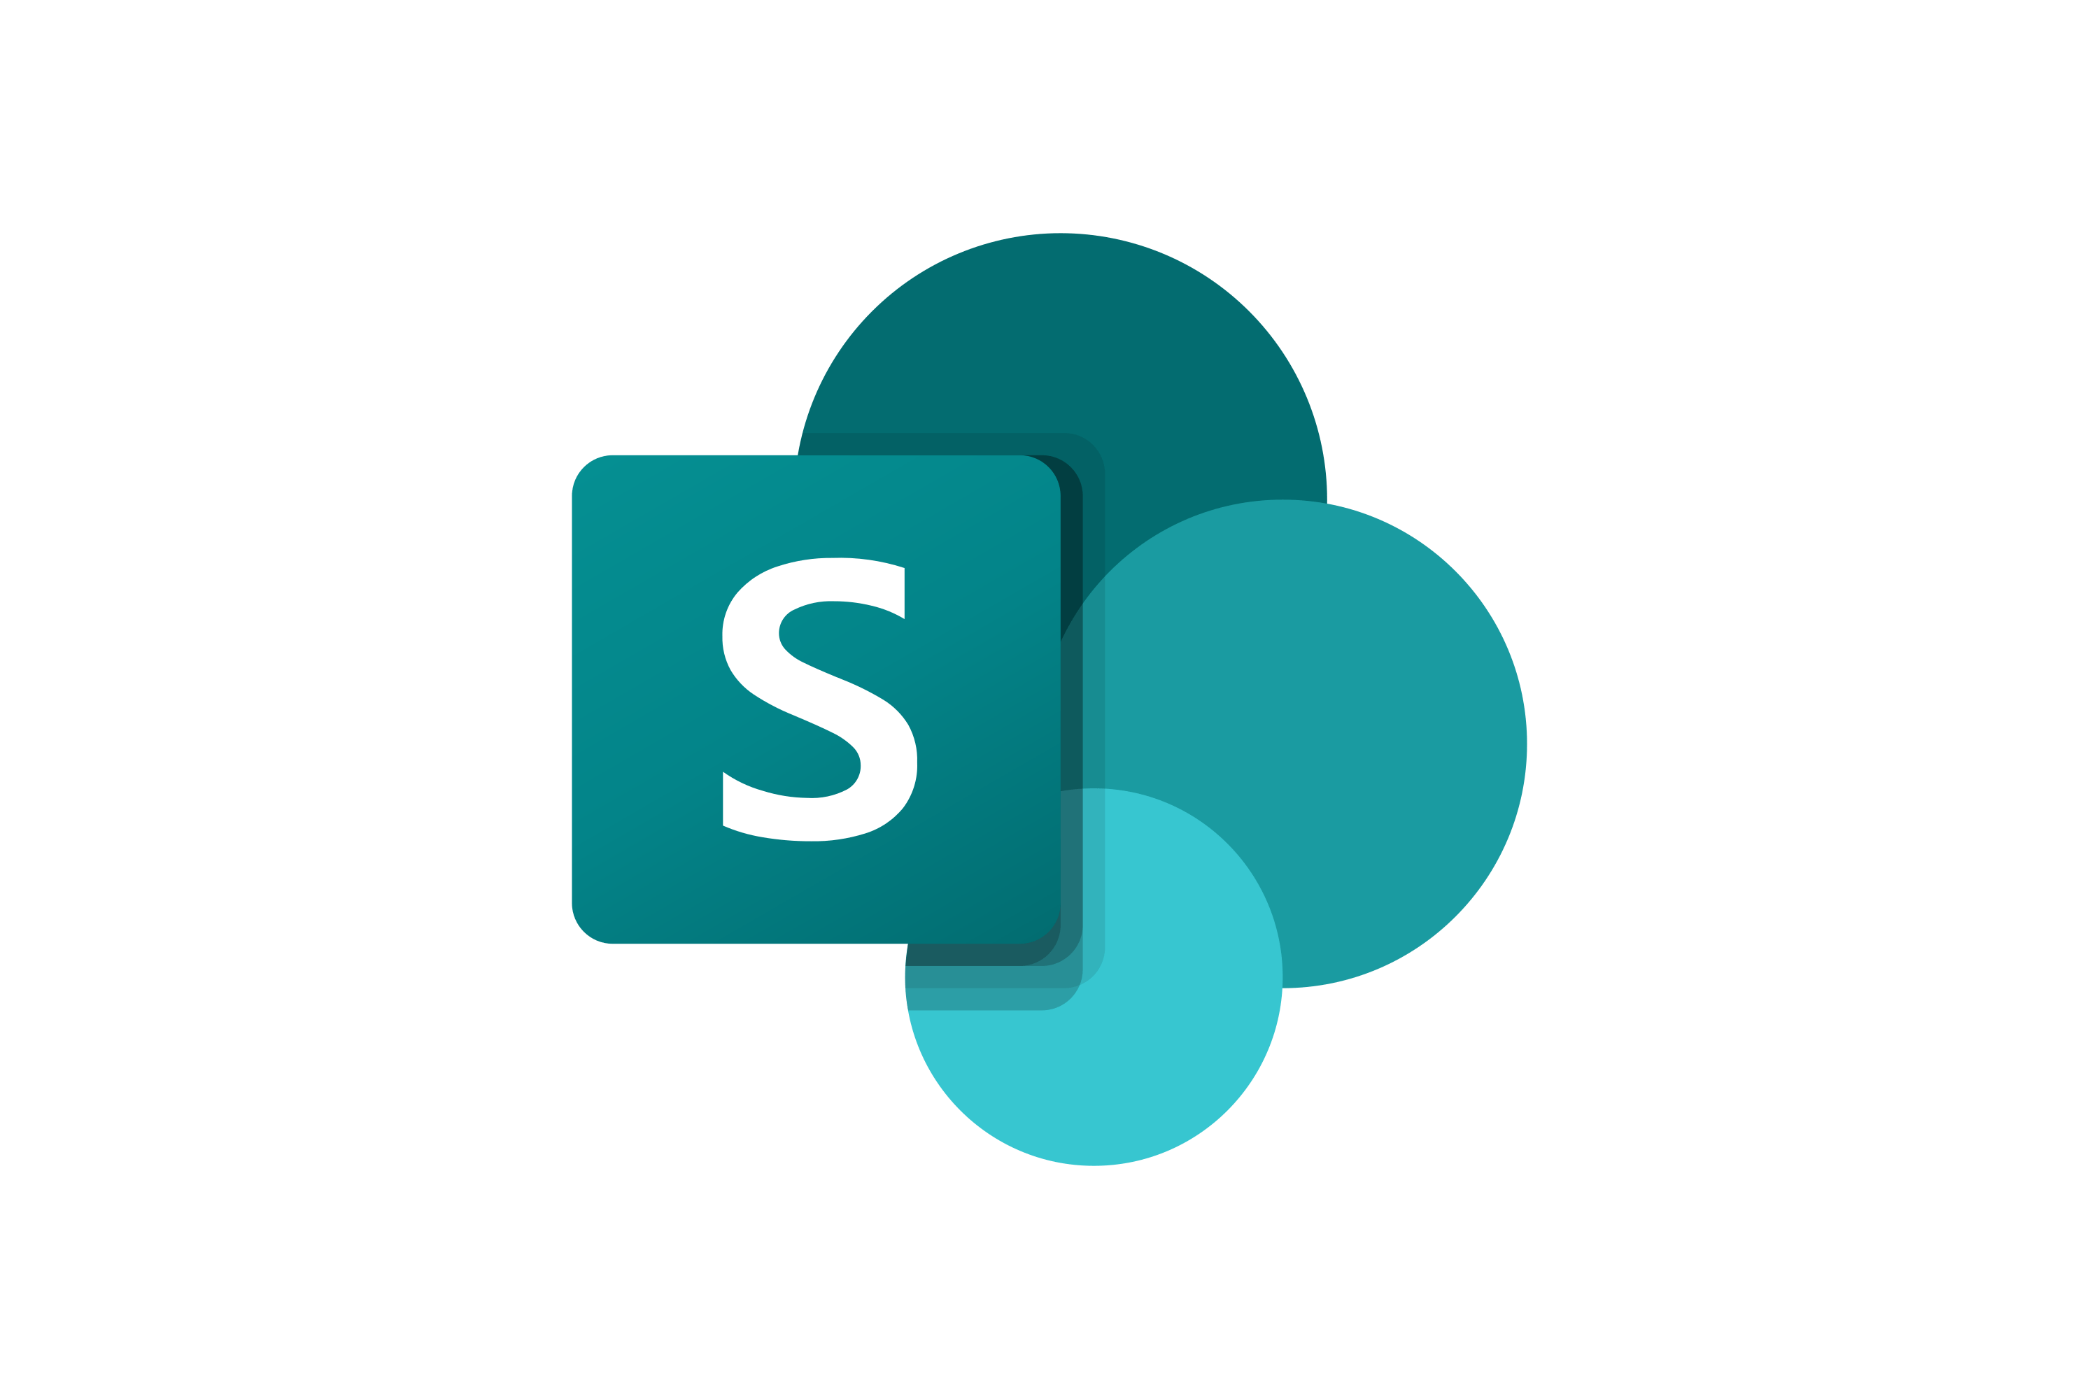



JIRA Application Architect Flow
Flow
Add
Edit/Update
Remove
Important Notes
1. Admin has an access to Create, Edit and Delete the information of users in share point using this application.
2. Stored data will managed securely in Power apps.
3. Using this app you can also view the Employee details.

